Slide 1


Dual Integral Quadratic Constraints for Robust Control of Partial Integral Equations
An engineering overview
(a) Open-loop response
(b) Closed-loop response
T.M. Lenssen – supervisor: Amritam Das
$$2$$
$$2$$
$$0$$
$$(1,0)$$
$$0$$
$$(1,0)$$
$$5$$
$$10$$
$$0.75$$
$$-2$$
$$5$$
$$10$$
$$0.75$$
$$15$$
$$s = 0.5$$
$$15$$
$$s = 0.5$$
$$-2$$
$$t = 20$$
$$25$$
$$0.25$$
$$t = 20$$
$$25$$
$$0.25$$
$$30$$
$$35$$
$$0$$
$$30$$
$$35$$
$$0$$
CS – System & Control / 30-09-2026
$$-2$$
$$x(t,s) = 0$$
$$2$$
$$-2$$
$$x(t,s) = 0$$
$$2$$

Slide 2



Rigid body representation
Ordinary Differential Equation (ODE)
Flexible body representation
Partial Differential Equation (PDE)
$$Target r\left(t\right)$$
$$Target r\left(t\right)$$
$$s$$
$$q\left(t\right)$$
$$q\left(t\right)+w\left(t,L\right)$$
$$q\left(t\right)$$
$$q\left(t\right)$$
$$M\ddot{q}\left(t\right)=F\left(t\right)$$
$$ρA\left[w_{tt}\left(t,s\right)+\ddot{q}\left(t\right)\right]+EIw_{ssss}\left(t,s\right)+ηw_{tssss}\left(t,s\right)=0, 0<s<L$$
$$F\left(t\right)=M\left[{ω_{c}\left(t\right)}^{2}\left(r\left(t\right)−q\left(t\right)\right)−2ω_{c}\left(t\right)\dot{q}\left(t\right)\right]$$
$$w\left(t,0\right)=w_{s}\left(t,0\right)=0, EIw_{ss}\left(t,L\right)+ηw_{tss}\left(t,L\right)=0$$
$$EIw_{sss}\left(t,L\right)+ηw_{tsss}\left(t,L\right)=0$$
$$\ddot{q}\left(t\right)+2ω_{c}\left(t\right)\dot{q}\left(t\right)+{ω_{c}\left(t\right)}^{2}\left[q\left(t\right)−r\left(t\right)\right]=0$$
Notes:
This slide serves as an intuitive yet insightful slide to explain PDEs, it shows the limitations of a rigid body representation as we push for performance where partial differential equations could better capture the flexmodes of the system such that we can account for them in analysis, observation or controlling the system.
That additional detail comes with greater complexity: PDE models involve infinitely many modes, spatial distributed dynamics, and boundary conditions, making analysis and design more challenging.

Slide 3





ASML wafer stage
Canon Production Printing
Parkinsons Disease
BASAL GANGLIA
FRONTAL LOBE
BASAL GANGLIA
THALAMUS
Drying air
Evaporation
Heat
Moisture
Wave/beam equations (PDE)
Diffusion-Reaction Equations (PDE)
Differential Delay Equations
(DDE -> PDE)
Notes:
This is especially relevant at ASML, where we want to achieve as much throughput as possible. The wafer stage carries the chips and needs to move as fast as possible, while still reaching nanometer-level precision.
This creates a trade-off between weight and stiffness. A lighter stage can move faster under the same forces, but it also becomes more flexible, which makes it harder to position accurately. As we saw on the previous slide, this flexibility can be described using partial differential equations instead of ordinary, or lumped, differential equations. Typical examples are wave and beam equations.
Another example is large-scale production printing at Canon in Venlo. If a wet piece of paper dries in an uncontrolled way, it can wrinkle or deform. The same problem appears in printing, because the paper becomes slightly wet during the printing process and then needs to be dried in a controlled way.
Again, there is a trade-off between throughput and quality. Drying faster increases production speed, but if the temperature or moisture is not distributed evenly across the paper, the paper can deform. Since heat and moisture vary across both space and time, this again naturally leads to partial differential equations.
The final, seemingly unrelated example is Parkinson’s disease. In a healthy person, the cortex generates possible actions and sends this information to the basal ganglia. The basal ganglia help select which actions should be carried out and which should be suppressed. This information is then passed through the thalamus back to the motor cortex, which helps execute the movement.
In patients with Parkinson’s disease, this selection mechanism is disturbed because of a loss of dopamine. As a result, the basal ganglia suppress movement too strongly, making it harder to start and control movements. This leads to symptoms such as slow movement, stiffness, and tremor.
Although this problem looks very different from a wafer stage or a drying sheet of paper, it also involves dynamics that are distributed over space. In all three examples, the main challenge is the same: we want to understand and control systems whose behavior cannot be described well by only a few lumped variables.

Slide 4
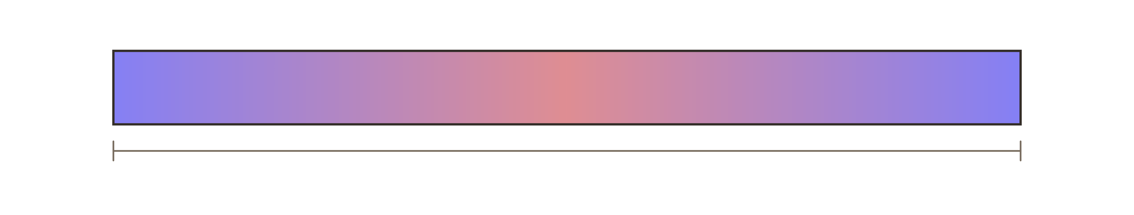
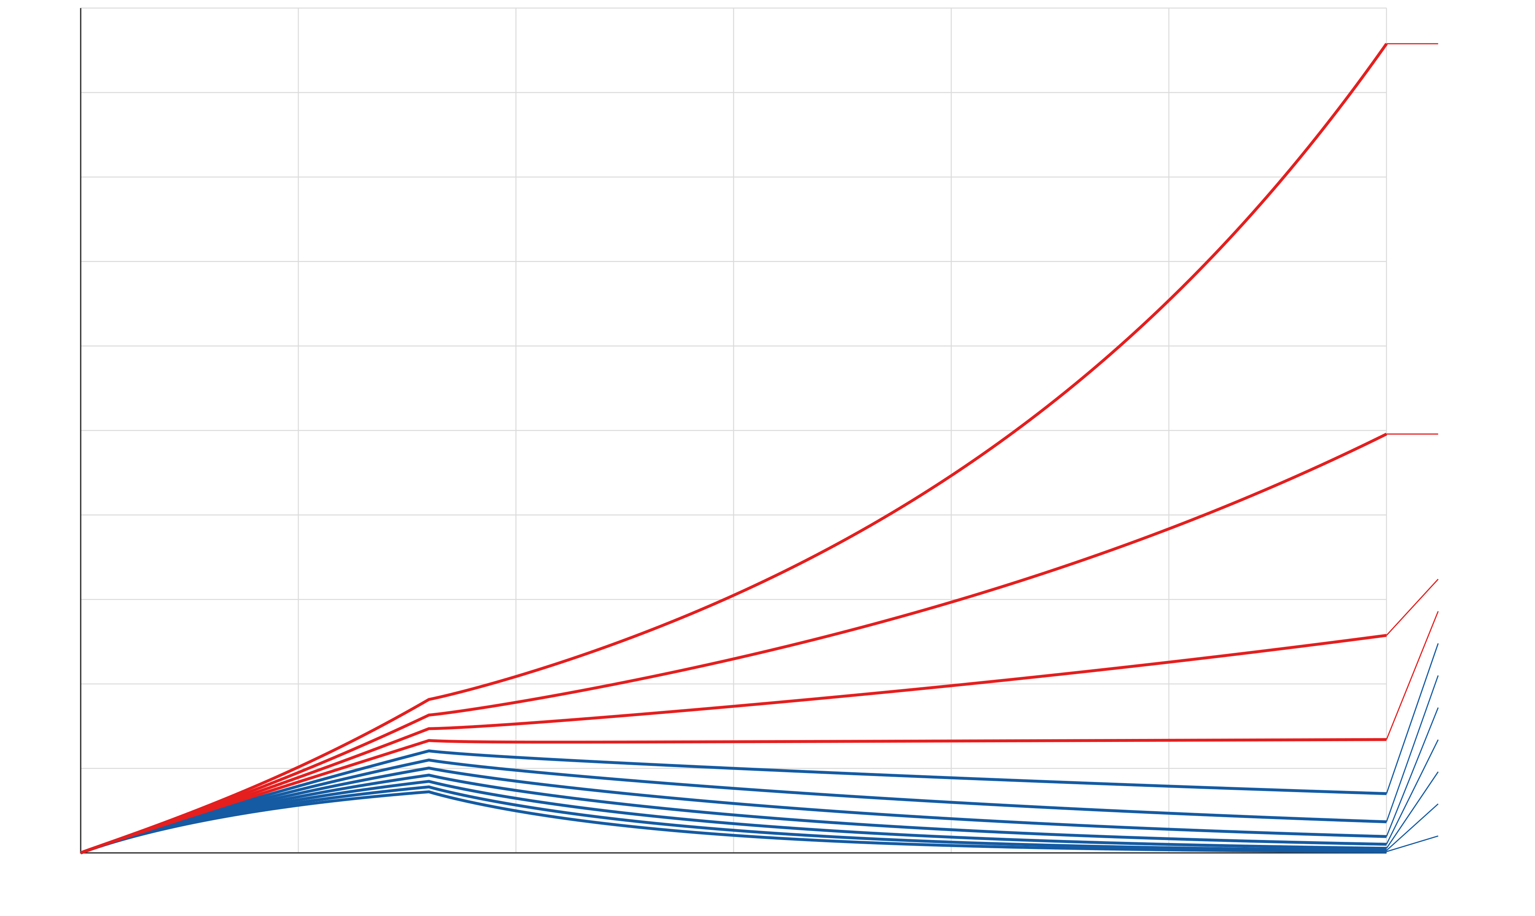

$$temp($$
$$t,$$
$$0) = 0$$
$$temp($$
$$t,$$
$$1) = 0$$
Temp in paper
$$s$$
$$= 0$$
$$s$$
$$s$$
$$= 1$$
$${heat}_{t}\left(t,s\right)=0.01 {heat}_{ss}\left(t,s\right)+\left[\underset{\text{heat generation}}{\underbrace{0.25\left(1+δ\right)}}−\underset{\text{cooling}}{\underbrace{0.2}}\right]heat\left(t,s\right)+u\left(t\right)$$
100
$$δ=0.5$$
90
80
$$δ∈[−0.5,0.5]$$
70
60
Cite paper
Average temperature
$$δ=0.4$$
50
40
$$δ=0.3$$
30
$$δ=0.2$$
$$δ=0.1$$
20
$$δ=0.0$$
$$δ=-0.1$$
$$δ=-0.2$$
10
$$δ=-0.3$$
$$δ=-0.4$$
0
$$δ=-0.5$$
0
5
10
15
20
25
30
$$t$$
Notes:
To explain robust control, let’s take a simplified version of our printing process. See here the model of a cross-section of a piece of paper. For illustrative purposes, suppose it is heated up during the printing process, after which it needs to be cooled. Let’s also suppose our piece of paper is very poor at conducting heat.
This cooling is affected by the ambient temperature in the spot where the printer is situated, which can deviate from day to day, for example due to the weather or air-conditioning settings. This deviation is captured by the variable $δ$. As we increase $δ$, we increase the ambient temperature and thus make it more difficult for our paper to cool down.
At some point, our poorly heat-conducting paper can no longer dissipate enough heat and no longer behaves as desired and thus start to heat up. One example of robust analysis is then to determine for which values of $δ$the paper still cools down properly, without having to simulate the system for an infinite number of possible values of $δ$.
This robust analysis problem was the focus of my internship. For my graduation thesis, I then took the next step and focused on robust control: not only determining whether the system behaves correctly under uncertainty, but designing a controller that makes sure it does.

Slide 5
BASAL GANGLIA
FRONTAL LOBE
BASAL GANGLIA
THALAMUS

Slide 6
BASAL GANGLIA
FRONTAL LOBE
BASAL GANGLIA
THALAMUS

Slide 7


Neural Mass Model
$$X$$
$$+$$
Proto
STN
$$−$$
$$−$$
$$X$$
$$X$$
$$\begin{aligned}z_{S}\left(t\right)&=−x_{G}\left(t−τ_{GS}\right), \\ z_{G}\left(t\right)&=x_{S}\left(t−τ_{SG}\right)−x_{G}\left(t−τ_{GG}\right), \\ \\ \end{aligned}$$
[2] Firing rate models
Notes:
In de praktijk wordt er een elektrode op de stn gezet om deep brain stimulation.
Correlatie tussen oscilatie en traagheid van bewegingen. Dus de vraag is dan kunnen we het brein zo stimuleren dat we de oscilaties verminderen
Remende effect is inhibitory
Gaspedaal is exhibitory

Slide 8
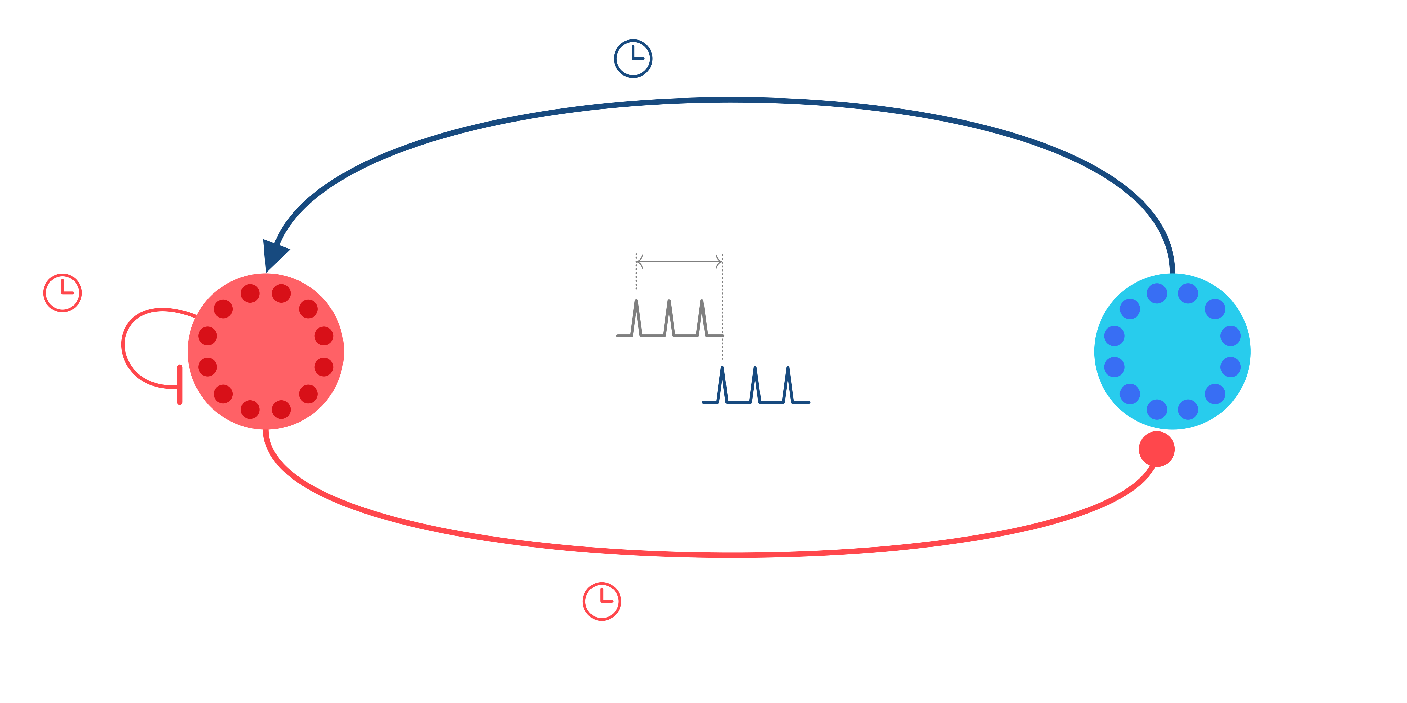

Neural Mass Model
$$τ$$
$$SG$$
$$= 6 ms$$
$$+$$
$$τ$$
$$ij$$
$$τ$$
$$GG$$
Proto
STN
$$= 4 ms$$
$$−$$
$$−$$
$$τ$$
$$GS$$
$$= 6 ms$$
$$\begin{aligned}z_{S}\left(t\right)&=−x_{G}\left(t−τ_{GS}\right), \\ z_{G}\left(t\right)&=x_{S}\left(t−τ_{SG}\right)−x_{G}\left(t−τ_{GG}\right), \\ \\ \end{aligned}$$
[2] Firing rate models
Notes:
In de praktijk wordt er een elektrode op de stn gezet om deep brain stimulation.
Correlatie tussen oscilatie en traagheid van bewegingen. Dus de vraag is dan kunnen we het brein zo stimuleren dat we de oscilaties verminderen
Remende effect is inhibitory
Gaspedaal is exhibitory

Slide 9
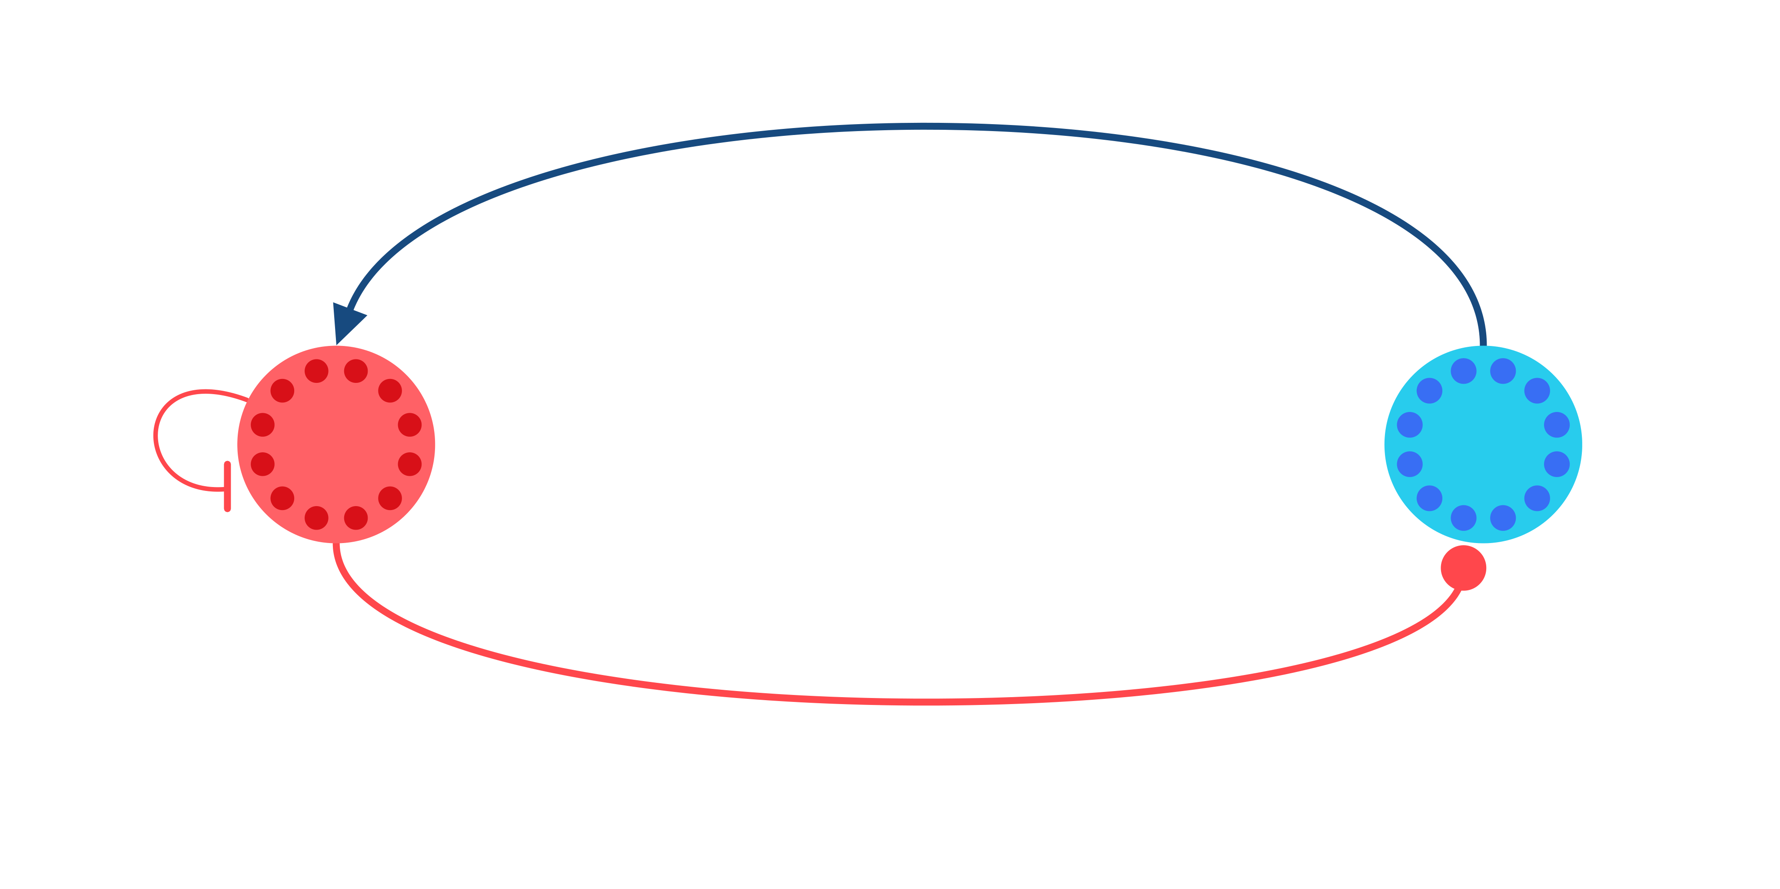

Neural Mass Model
$$w$$
$$SG$$
$$+$$
$$w$$
$$GG$$
Proto
STN
$$−$$
$$−$$
$$w$$
$$GS$$
$$\begin{aligned}z_{S}\left(t\right)&=−w_{GS}x_{G}\left(t−τ_{GS}\right), \\ z_{G}\left(t\right)&=w_{SG}x_{S}\left(t−τ_{SG}\right)−w_{GG}x_{G}\left(t−τ_{GG}\right), \\ \\ \end{aligned}$$
[2] Firing rate models
Notes:
In de praktijk wordt er een elektrode op de stn gezet om deep brain stimulation.
Correlatie tussen oscilatie en traagheid van bewegingen. Dus de vraag is dan kunnen we het brein zo stimuleren dat we de oscilaties verminderen
Remende effect is inhibitory
Gaspedaal is exhibitory

Slide 10
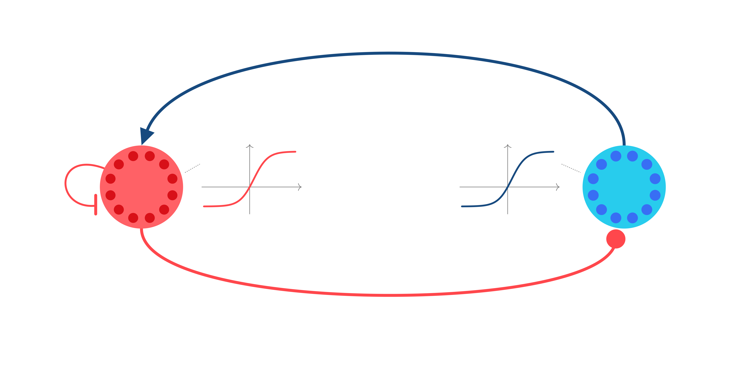

Neural Mass Model
$$+$$
$$δ$$
$$($$
$$z$$
$$)$$
$$δ$$
$$($$
$$z$$
$$)$$
$$G$$
$$G$$
$$S$$
$$S$$
Proto
$$z$$
$$z$$
STN
$$−$$
$$G$$
$$S$$
$$−$$
$$\begin{aligned}z_{S}\left(t\right)&=−w_{GS}x_{G}\left(t−τ_{GS}\right), \\ z_{G}\left(t\right)&=w_{SG}x_{S}\left(t−τ_{SG}\right)−w_{GG}x_{G}\left(t−τ_{GG}\right), \\ τ_{S}{\dot{x}}_{S}\left(t\right)&=δ_{S}\left(z_{S}\left(t\right)\right)−x_{S}\left(t\right), \\ τ_{G}{\dot{x}}_{G}\left(t\right)&=δ_{G}\left(z_{G}\left(t\right)\right)−x_{G}\left(t\right).\end{aligned}$$
Model contains delays and nonlinear activation funtions!
[2] Firing rate models
Notes:
In de praktijk wordt er een elektrode op de stn gezet om deep brain stimulation.
Correlatie tussen oscilatie en traagheid van bewegingen. Dus de vraag is dan kunnen we het brein zo stimuleren dat we de oscilaties verminderen
Remende effect is inhibitory
Gaspedaal is exhibitory

Slide 11
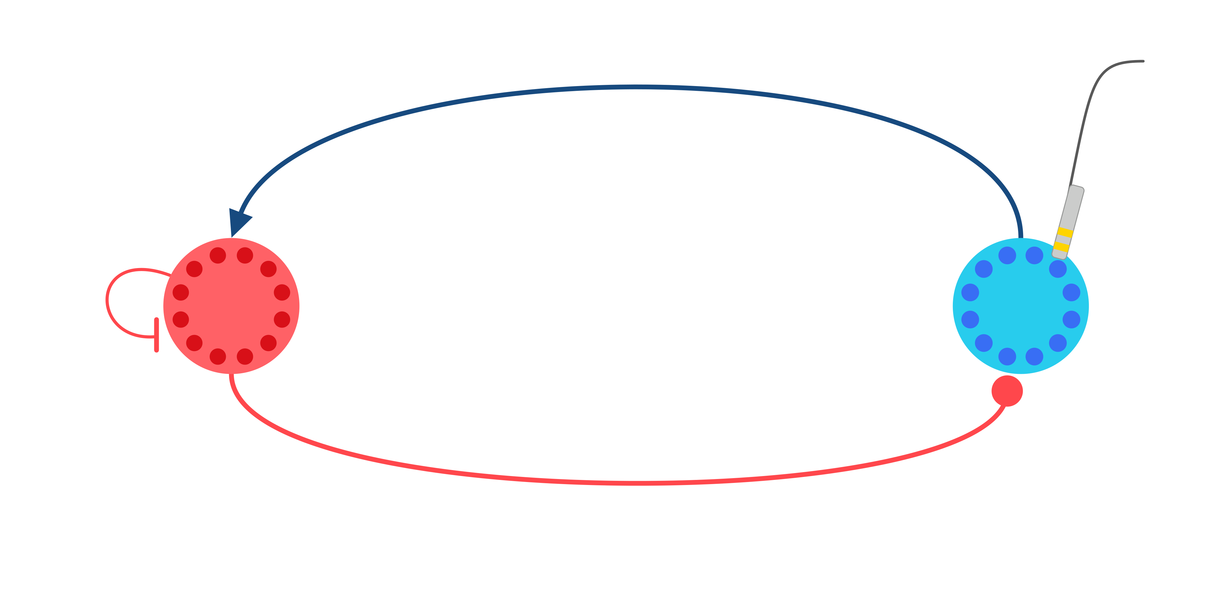

Neural Mass Model
$$u$$
$$($$
$$t$$
$$)$$
$$+$$
Proto
STN
$$−$$
$$−$$
$$\begin{aligned}z_{S}\left(t\right)&=−w_{GS}x_{G}\left(t−τ_{GS}\right), \\ z_{G}\left(t\right)&=w_{SG}x_{S}\left(t−τ_{SG}\right)−w_{GG}x_{G}\left(t−τ_{GG}\right), \\ τ_{S}{\dot{x}}_{S}\left(t\right)&=δ_{S}\left(z_{S}\left(t\right)\right)−x_{S}\left(t\right)+u\left(t\right), \\ τ_{G}{\dot{x}}_{G}\left(t\right)&=δ_{G}\left(z_{G}\left(t\right)\right)−x_{G}\left(t\right).\end{aligned}$$
[2] Firing rate models
Notes:
In de praktijk wordt er een elektrode op de stn gezet om deep brain stimulation.
Correlatie tussen oscilatie en traagheid van bewegingen. Dus de vraag is dan kunnen we het brein zo stimuleren dat we de oscilaties verminderen
Remende effect is inhibitory
Gaspedaal is exhibitory

Slide 12
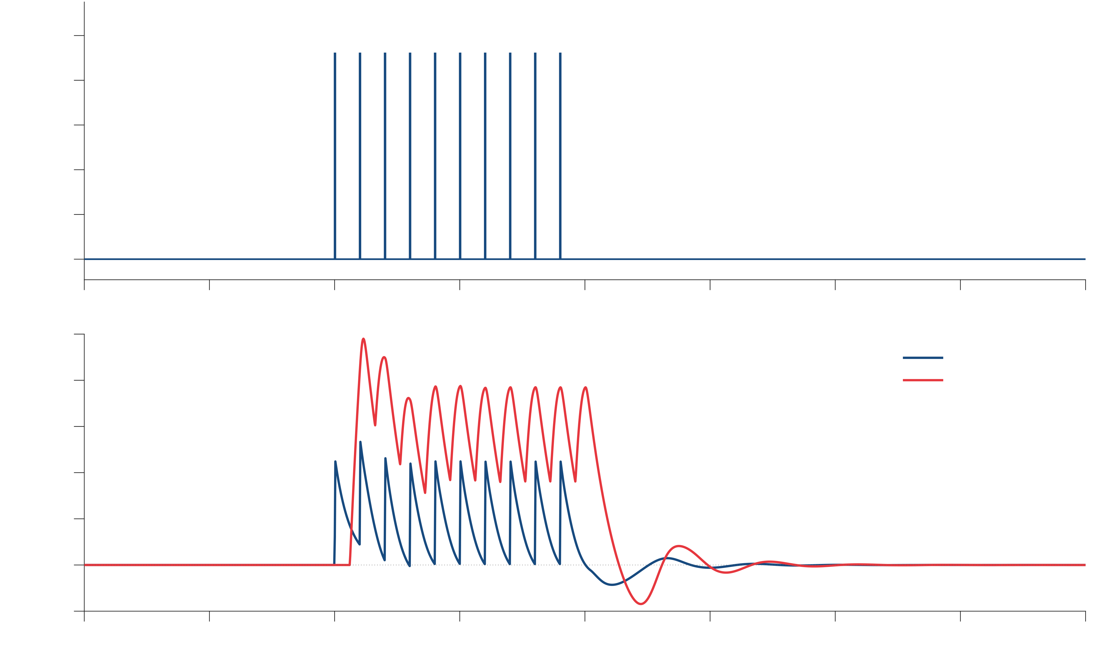
Brain Stimulation
$$w$$
$$SG$$
$$= 19$$
$$.$$
$$0$$
$$u$$
$$($$
$$t$$
$$)$$
1000
800
$$+$$
spikes/s
600
400
$$w$$
$$GG$$
200
$$6$$
$$.$$
$$60$$
Proto
Healthy
STN
0
$$−$$
$$−$$
0
0.05
0.1
0.15
0.2
0.25
0.3
0.35
0.4
100
x
(STN)
80
x
S
(GPe / Proto)
G
60
$$w$$
$$.$$
$$12$$
spikes/s
$$GS$$
$$= 1$$
40
20
0
-20
0
0.05
0.1
0.15
0.2
0.25
0.3
0.35
0.4
t
[2] Firing rate models
Notes:
In de praktijk wordt er een elektrode op de stn gezet om deep brain stimulation.
Correlatie tussen oscilatie en traagheid van bewegingen. Dus de vraag is dan kunnen we het brein zo stimuleren dat we de oscilaties verminderen
Remende effect is inhibitory
Gaspedaal is exhibitory

Slide 13
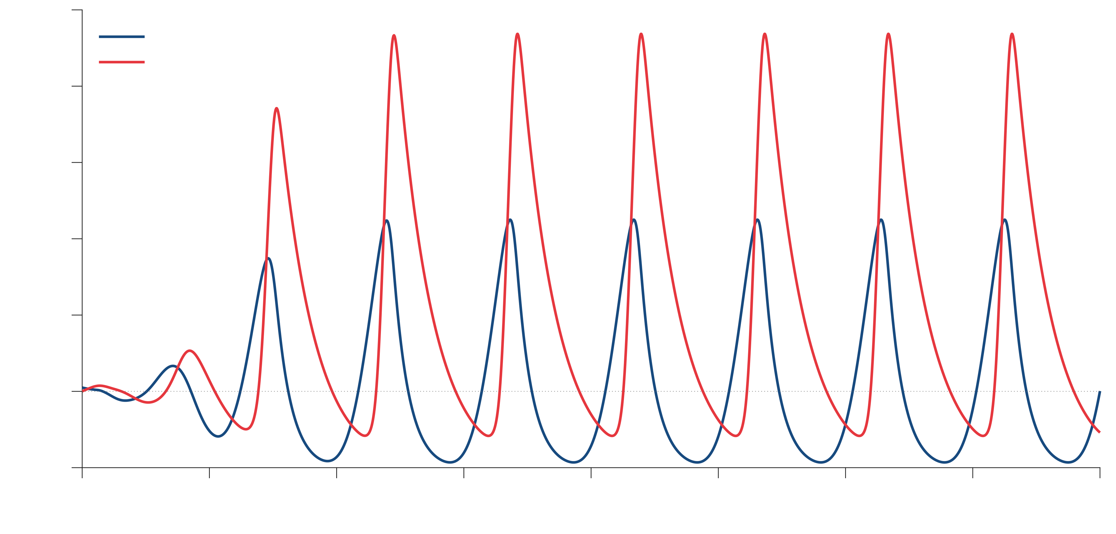
Beta-oscilations
$$w$$
$$SG$$
$$= 20$$
$$.$$
$$0$$
$$u$$
$$($$
$$t$$
$$)$$
100
x
(STN)
x
S
(GPe / Proto)
$$+$$
80
G
$$w$$
$$GG$$
Suffering from
60
$$12$$
$$.$$
$$3$$
Proto
Parkinson’s
STN
$$−$$
spikes/s
$$−$$
40
20
$$w$$
$$= 10$$
$$.$$
$$7$$
0
$$GS$$
-20
0
0.05
0.1
0.15
0.2
0.25
0.3
0.35
0.4
t
[2] Firing rate models
Notes:
In de praktijk wordt er een elektrode op de stn gezet om deep brain stimulation.
Correlatie tussen oscilatie en traagheid van bewegingen. Dus de vraag is dan kunnen we het brein zo stimuleren dat we de oscilaties verminderen
Remende effect is inhibitory
Gaspedaal is exhibitory

Slide 14
Goal: Develop a unified framework to analyse and control a broad class of distributed systems.
Analysis capabilities
Convex state feedback synthesis

Slide 15
Goal: Develop a unified framework to analyse and control a broad class of distributed systems.
Analysis capabilities
Convex state feedback synthesis

Slide 16
Goal: Develop a unified framework to analyse and control a broad class of distributed systems.
Analysis capabilities
Convex state feedback synthesis
Main contribution
Notes:
Assume full state information is known
Needs to be satisfied for all uncertainty, infinite dimensional system, uncertainty
Thinking of discretization have already lost the battle, the physics of the system determines that PDE is the representation of the system. First thing AI tries to do is discretize the model

Slide 17

$$u$$
$$($$
$$t$$
$$)$$
$$+$$
Proto
STN
$$−$$
$$−$$
$$\begin{aligned}z_{S}\left(t\right)&=−w_{GS}x_{G}\left(t−τ_{GS}\right), \\ z_{G}\left(t\right)&=w_{SG}x_{S}\left(t−τ_{SG}\right)−w_{GG}x_{G}\left(t−τ_{GG}\right), \\ τ_{S}{\dot{x}}_{S}\left(t\right)&=δ_{S}\left(z_{S}\left(t\right)\right)−x_{S}\left(t\right)+u\left(t\right), \\ τ_{G}{\dot{x}}_{G}\left(t\right)&=δ_{G}\left(z_{G}\left(t\right)\right)−x_{G}\left(t\right).\end{aligned}$$
[2] Firing rate models
Notes:
In de praktijk wordt er een elektrode op de stn gezet om deep brain stimulation.
Correlatie tussen oscilatie en traagheid van bewegingen. Dus de vraag is dan kunnen we het brein zo stimuleren dat we de oscilaties verminderen
Remende effect is inhibitory
Gaspedaal is exhibitory

Slide 18
Partial Integral Equations
Equivalent dynamics
Built in boundary conditions
Bounded operators
Matrix-like algebra
LMI-like computations
Controller synthesis for linear systems…..
ODE-PDE
PIE
Exact!
Notes:
Partial Differential Equations give a natural way to describe distributed systems, but stability analysis, observer design, and controller synthesis are challenging. Spatially distributed dynamics and boundary conditions complicate the application of large amount of theory that has been developed for ordinary differential equations.
More recently, partial differential equations have been introduced as an alternative representation that brings much of the properties of ODEs to partial differential equations.

Slide 19


Partial Integral Equations
Equivalent dynamics
Built in boundary conditions
Bounded operators
Matrix-like algebra
LMI-like computations
Controller synthesis for linear systems…..
ODE-PDE
PIE
Exact!
$$\dot{T}\left(t,s\right)=T\left(t,s\right)$$
$$T\left(t,0\right)=w_{1}\left(t\right)$$
$$T_{s}\left(t,0\right)=w_{2}(t)$$
$$\begin{aligned}\dot{u}\left(t,s\right)=w_{1}\left(t\right) \\ +sw_{2}\left(t\right) \\ +\int_{0}^{s}{\left(s−ξ\right)}u_{ξξ}\left(t,ξ\right)dξ\end{aligned}$$
Notes:
Partial Differential Equations give a natural way to describe distributed systems, but stability analysis, observer design, and controller synthesis are challenging. Spatially distributed dynamics and boundary conditions complicate the application of large amount of theory that has been developed for ordinary differential equations.
More recently, partial differential equations have been introduced as an alternative representation that brings much of the properties of ODEs to partial differential equations.

Slide 20
Partial Integral Equations
Equivalent dynamics
Built in boundary conditions
Bounded operators
Matrix-like algebra
LMI-like computations
Controller synthesis for linear systems…..
ODE-PDE
PIE
Exact!
$$𝒯{\dot{x}}_{f}\left(t\right)=𝒜x_{f}\left(t\right)+ℬw\left(t\right)$$
$$z\left(t\right)=𝒞x_{f}\left(t\right)+𝒟w\left(t\right)$$
$$𝒯,𝒜,....∈Π_{4}$$
Notes:
Partial Differential Equations give a natural way to describe distributed systems, but stability analysis, observer design, and controller synthesis are challenging. Spatially distributed dynamics and boundary conditions complicate the application of large amount of theory that has been developed for ordinary differential equations.
More recently, partial differential equations have been introduced as an alternative representation that brings much of the properties of ODEs to partial differential equations.

Slide 21
Partial Integral Equations
Equivalent dynamics
Built in boundary conditions
Bounded operators
Matrix-like algebra
LMI-like computations
Controller synthesis for linear systems…..
ODE-PDE
PIE
Exact!
$$𝒜+ℬ∈Π_{4}, 𝒜ℬ∈Π_{4}, 𝒜^{∗}∈Π_{4}, \left[\begin{matrix}𝒜 & ℬ\end{matrix}\right]∈Π_{4}$$
Notes:
Partial Differential Equations give a natural way to describe distributed systems, but stability analysis, observer design, and controller synthesis are challenging. Spatially distributed dynamics and boundary conditions complicate the application of large amount of theory that has been developed for ordinary differential equations.
More recently, partial differential equations have been introduced as an alternative representation that brings much of the properties of ODEs to partial differential equations.

Slide 22
Partial Integral Equations
Equivalent dynamics
Built in boundary conditions
Bounded operators
Matrix-like algebra
LMI-like computations
Controller synthesis for linear systems…..
ODE-PDE
PIE
Exact!
Exponential stability of PDE
$$∃𝒫≻0, 𝒯^{∗}𝒫𝒜+𝒜^{∗}𝒫𝒯⪯−α𝒯^{∗}𝒫𝒯$$
Notes:
Partial Differential Equations give a natural way to describe distributed systems, but stability analysis, observer design, and controller synthesis are challenging. Spatially distributed dynamics and boundary conditions complicate the application of large amount of theory that has been developed for ordinary differential equations.
More recently, partial differential equations have been introduced as an alternative representation that brings much of the properties of ODEs to partial differential equations.

Slide 23
Partial Integral Equations
Equivalent dynamics
Built in boundary conditions
Bounded operators
Matrix-like algebra
LMI-like computations
Controller synthesis for linear systems…..
ODE-PDE
PIE
Exact!
Cite gpde application
Notes:
Partial Differential Equations give a natural way to describe distributed systems, but stability analysis, observer design, and controller synthesis are challenging. Spatially distributed dynamics and boundary conditions complicate the application of large amount of theory that has been developed for ordinary differential equations.
More recently, partial differential equations have been introduced as an alternative representation that brings much of the properties of ODEs to partial differential equations.
Five steps PDE to PIE,

Slide 24
Robust Stability and Performance
Notes:
For illustrative purposes, suppose this model the moisture and heat content of a piece of paper as it exits

Slide 25
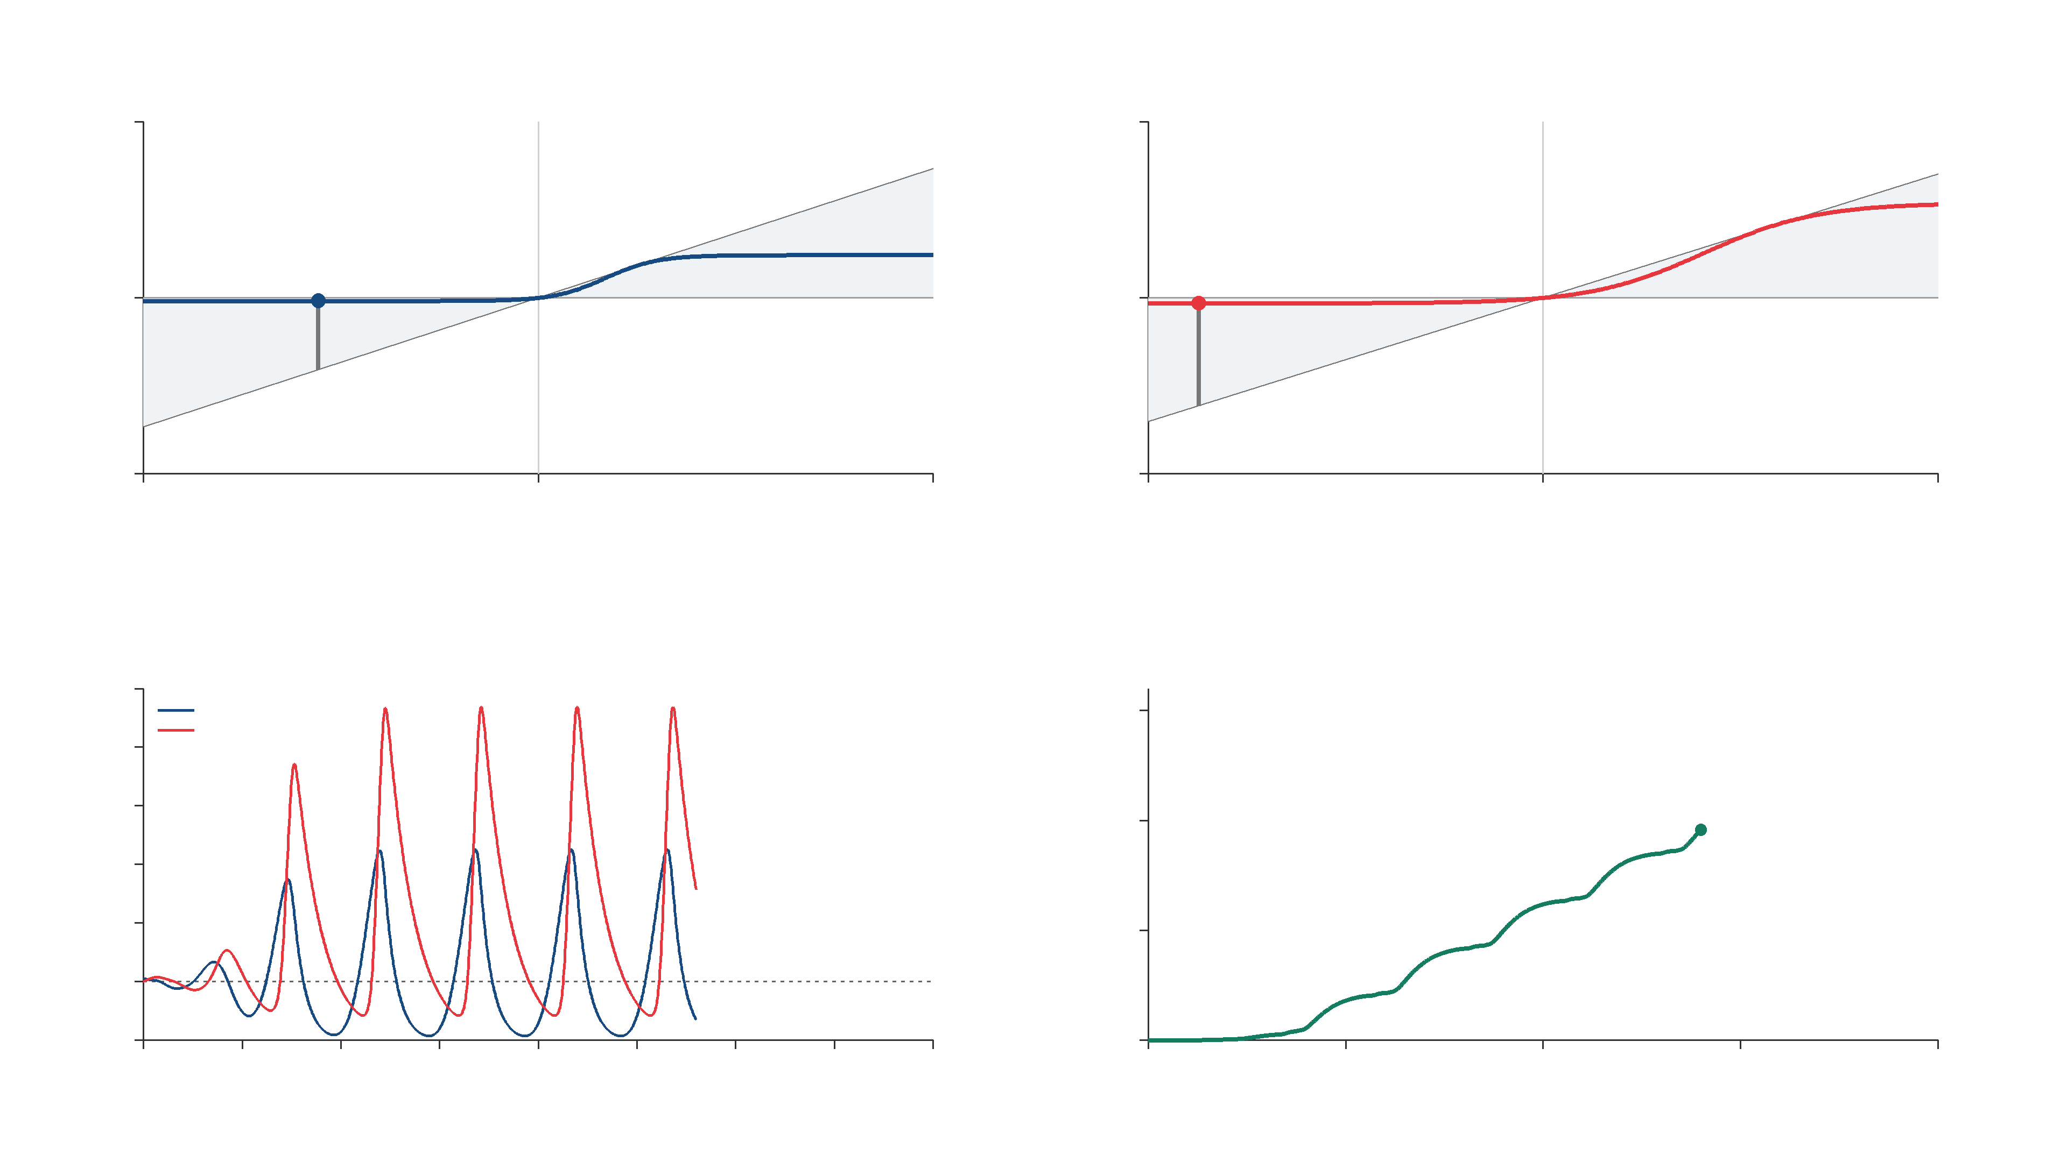
STN nonlinearity
GPe nonlinearity
1150
700
$$w_{S}\left(t\right)$$
$$w_{G}\left(t\right)$$
0
0
-1150
-700
-1150
0
1150
-700
0
700
$$z_{S}\left(t\right)$$
$$z_{G}\left(t\right)$$
Response
Supply function
100
$$x_{S} (STN)$$
3000
$$x_{G} (GPe / Proto)$$
80
60
2000
$$spikes/s$$
$$\int_{0}^{T}{σ\left(t\right) dt}$$
40
20
1000
0
-20
0
0
0.05
0.1
0.15
0.2
0.25
0.3
0.35
0.4
0
0.1
0.2
0.3
0.4
$$t (s)$$
$$T (s)$$
Notes:
Parkinsonian GPe-STN sector simulation. Each channel satisfies q_i=w_i(beta_i*z_i-w_i)>=0. The supply function panel plots the accumulated supply integral, giving the hard IQC and dissipativity with zero storage. beta_S=0.7344121335837432, beta_G=0.7048314668921489. Click to play the embedded clean 4K video; all text and math labels are editable PowerPoint overlays.

Slide 26









Heat in paper
Analysis
Moisture in paper
$$s$$
Replace $∆$ with some scaling
Cost function
$$\tilde{z}$$
$$Θ$$
$$\tilde{w}$$
$$Δ$$
$$z$$
$$w$$
$$P$$
$$ℐ≤−ε{\left\|p_{T}w\right\|}_{L_{[a,b]}}^{2}$$
Msc Defence T.M. Lenssen
29
Notes:
We use \gamma as a performance metric, where a lower gamma implies we can push for more performance. Before analyzing robust stability and performance we need to do something about this Delta as it makes analysis harder.
Introduce IQC for parametric uncertainty things we can do, keep the promise to show another example
Introduce duality argument for sector bounded uncertainty

Slide 27



Heat in paper
Analysis
Moisture in paper
$$s$$
Replace $∆$ with some scaling
Cost function
$$\tilde{z}$$
$$Θ$$
$$\tilde{w}$$
$$Δ$$
$$z$$
$$w$$
$$P$$
$$ℐ≤−ε{\left\|p_{T}w\right\|}^{2}$$
Convex for analysis!
Msc Defence T.M. Lenssen
29
Notes:
We use \gamma as a performance metric, where a lower gamma implies we can push for more performance. Before analyzing robust stability and performance we need to do something about this Delta as it makes analysis harder.

Slide 28

Heat in paper
Analysis
Moisture in paper
$$s$$
Final representation the system
Replace $∆$ with some scaling
Cost function
$$\tilde{z}$$
$$Θ$$
$$\tilde{w}$$
$$Δ$$
$$z$$
$$w$$
$$P$$
$$ℐ≤−ε{\left\|p_{T}w\right\|}^{2}$$
Msc Defence T.M. Lenssen
29
Notes:
We use \gamma as a performance metric, where a lower gamma implies we can push for more performance. Before analyzing robust stability and performance we need to do something about this Delta as it makes analysis harder.

Slide 29




Heat in paper
Let’s analyse!
Moisture in paper
$$s$$
$$Θ$$
$$\tilde{z}$$
$$Δ$$
$$\tilde{w}$$
$$z$$
$$w$$
$$P$$
$$ℐ≤−ε{\left\|p_{T}w\right\|}^{2}$$
Msc Defence T.M. Lenssen
29
Notes:
We use \gamma as a performance metric, where a lower gamma implies we can push for more performance. Before analyzing robust stability and performance we need to do something about this Delta as it makes analysis harder.

Slide 30
Future work
Extending the multiplier and uncertainty class
  Infinite dimensional multipliers: real parametric, and sector bounded uncertainty
  Finite dimensional mutlipliers: Strict Positive negative multipliers

Slide 31
References
[1] B.De la Crompe, M.Deffains, A.Leblois, N.Mallet, “Reevaluating the role of the STN-Gpe network in generating beta synchronized oscillatory activity in parkinsonism.”
[2]A.J. Nevado Holgade, J.R.Terry,R.Bogacz, “Conditions for the Generation of Beta Oscillations in the Subthalamic Nucleus-Globus Pallidus Network”

Slide 32







Robust Stability and Performance
$$v_{i}\left(t,0\right)=0$$
$$∂_{s}v_{i}\left(t,1\right)=0$$
$$v_{1}$$
Heat in paper
$$v_{2}$$
Moisture in paper
$$s=0$$
$$s$$
$$s=1$$
Msc Defence T.M. Lenssen
26
Notes:
Two fields on the same spatial domain: v1 is heat deviation and v2 is moisture deviation. Full model is unchanged; introduce the states first. Both schematic profiles start at zero on the left and flatten at the no-flux right boundary, using a sin(pi*s/2)-shaped colour progression. The two simple arrows show the +v1 coupling from heat to moisture and the -3v2 coupling from moisture to heat. They indicate reaction coupling, not spatial transport. Gradients illustrate a boundary-compatible profile, not a simulation result.

Slide 33
Robust Stability and Performance
$$v_{i}\left(t,0\right)=0$$
$$∂_{s}v_{i}\left(t,1\right)=0$$
$$v_{1}$$
Heat in paper
$$v_{2}$$
Moisture in paper
$$s=0$$
$$s$$
$$s=1$$
$$∂_{t}v_{1}\left(t,s\right)=∂_{ss}v_{1}\left(t,s\right)+a\left(δ\right)v_{1}\left(t,s\right)−3v_{2}\left(t,s\right)+b\left(δ\right)sw_{p}\left(t\right)$$
$$∂_{t}v_{2}\left(t,s\right)=∂_{ss}v_{2}\left(t,s\right)+v_{1}\left(t,s\right)+\left(1+\frac{π^{2}}{2}\right)v_{2}\left(t,s\right)$$
$$z_{p}\left(t\right)=c\left(δ\right)\int_{0}^{1}{v_{1}\left(t,s\right) ds}+d\left(δ\right)w_{p}\left(t\right)$$
Msc Defence T.M. Lenssen
26
Notes:
Two fields on the same spatial domain: v1 is heat deviation and v2 is moisture deviation. Full model is unchanged; introduce the states first. Both schematic profiles start at zero on the left and flatten at the no-flux right boundary, using a sin(pi*s/2)-shaped colour progression. The two simple arrows show the +v1 coupling from heat to moisture and the -3v2 coupling from moisture to heat. They indicate reaction coupling, not spatial transport. Gradients illustrate a boundary-compatible profile, not a simulation result.

Slide 34

Robust Stability and Performance
$$v_{i}\left(t,0\right)=0$$
$$∂_{s}v_{i}\left(t,1\right)=0$$
$$v_{1}$$
Heat in paper
$$\left|δ\right|≤α$$
$$v_{2}$$
Moisture in paper
$$s=0$$
$$s$$
$$s=1$$
$$∂_{t}v_{1}\left(t,s\right)=∂_{ss}v_{1}\left(t,s\right)+a\left(δ\right)v_{1}\left(t,s\right)−3v_{2}\left(t,s\right)+b\left(δ\right)sw_{p}\left(t\right)$$
$$∂_{t}v_{2}\left(t,s\right)=∂_{ss}v_{2}\left(t,s\right)+v_{1}\left(t,s\right)+\left(1+\frac{π^{2}}{2}\right)v_{2}\left(t,s\right)$$
$$z_{p}\left(t\right)=c\left(δ\right)\int_{0}^{1}{v_{1}\left(t,s\right) ds}+d\left(δ\right)w_{p}\left(t\right)$$
Msc Defence T.M. Lenssen
27
Notes:
For illustrative purposes, suppose this model the moisture and heat content of a piece of paper as it exits

Slide 35

Robust Stability and Performance
$$v_{i}\left(t,0\right)=0$$
$$∂_{s}v_{i}\left(t,1\right)=0$$
$$v_{1}$$
Heat in paper
$$\left|δ\right|≤α$$
$$v_{2}$$
Moisture in paper
$$s=0$$
$$s$$
$$s=1$$
$$∂_{t}v_{1}\left(t,s\right)=∂_{ss}v_{1}\left(t,s\right)+a\left(δ\right)v_{1}\left(t,s\right)−3v_{2}\left(t,s\right)+b\left(δ\right)sw_{p}\left(t\right)$$
$$∂_{t}v_{2}\left(t,s\right)=∂_{ss}v_{2}\left(t,s\right)+v_{1}\left(t,s\right)+\left(1+\frac{π^{2}}{2}\right)v_{2}\left(t,s\right)$$
$$z_{p}\left(t\right)=c\left(δ\right)\int_{0}^{1}{v_{1}\left(t,s\right) ds}+d\left(δ\right)w_{p}\left(t\right)$$
Msc Defence T.M. Lenssen
28
Notes:
w_p models some heat disturbance acting on the piece of paper as it is leaving the printer, such as drying heat, warm airflow, or ambient temperature. Our performance channel z_p wants to know what effect this disturbance has on the average temperature of our sheet of paper. Lets put this equation in to a more generic form that is easier to interpret the LFR structure

Slide 36








Robust Stability and Performance
Heat in paper
Moisture in paper
$$s$$
$$\left|δ\right|≤α$$
$$Δ$$
$$w_{Δ}$$
$$z_{Δ}$$
Delta: captures uncertainty
P: captures nominal/linear dynamics
$$P$$
$$w_{p}$$
$$z_{p}$$
Msc Defence T.M. Lenssen
29
Notes:
For illustrative purposes, suppose this model the moisture and heat content of a piece of paper as it exits

Slide 37



Robust Stability and Performance
Heat in paper
Moisture in paper
$$s$$
$$Δ$$
Robust Stability: $[P,Δ]$ stable for all $\left|δ\right|≤α$
$$w_{Δ}$$
$$z_{Δ}$$
$$P$$
Msc Defence T.M. Lenssen
29
Notes:
For illustrative purposes, suppose this model the moisture and heat content of a piece of paper as it exits

Slide 38



Robust Stability and Performance
Heat in paper
Moisture in paper
$$s$$
$$Δ$$
Robust Performance: $[P,Δ]$ stable and performance
requirements are met for all $\left|δ\right|≤α$
$$w_{Δ}$$
$$z_{Δ}$$
$$P$$
$$w_{p}$$
$$z_{p}$$
Msc Defence T.M. Lenssen
29
Notes:
For illustrative purposes, suppose this model the moisture and heat content of a piece of paper as it exits

Slide 39



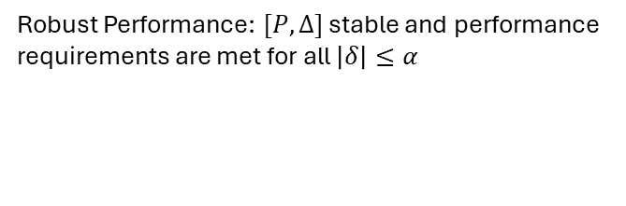
Robust Stability and Performance
Heat in paper
Moisture in paper
$$s$$
$$Δ$$
Robust Performance: $[P,Δ]$ stable and performance
requirements are met for all $\left|δ\right|≤α$
$$w_{Δ}$$
$$z_{Δ}$$
$$P$$
Performance metric: ${\left\|z_{p}(t)\right\|}_{L_{2}}≤γ{\left\|w_{p}(t)\right\|}_{L_{2}}$
$$w_{p}$$
$$z_{p}$$
Worst case gain!
Msc Defence T.M. Lenssen
29
Notes:
We use \gamma as a performance metric, where a lower gamma implies we can push for more performance. Before analyzing robust stability and performance we need to do something about this Delta as it makes analysis harder.

